Slide 1
Short Notes on Gateway, Bridges and IP Addressing
Name : Rupak Sarkar Roll No.: 14271024036 Stream : MCA Semester : Semester 2nd Subject : Networking Subject Code : MCAN-204

Slide 2
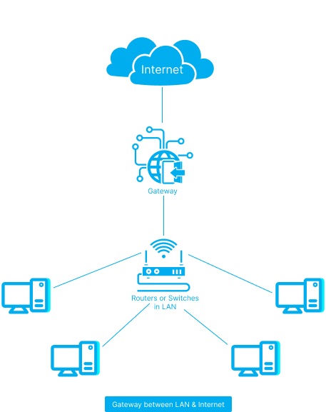
What is a Gateway?
A gateway is a network connectivity device that connects two different configuration networks. Gateways are also known as protocol converters, because they play an important role in converting protocols supported by traffic on different networks.
Features of Gateways
A gateway is situated at a network edge and manages all data that enters or exits the network.
A gateway is distinct from other network devices in that it can operate at any layer of the OSI model.
Gateways made the transmission more feasible as it queued up all the data and divided it into small packets of data rather than sending it bulk.

Slide 3
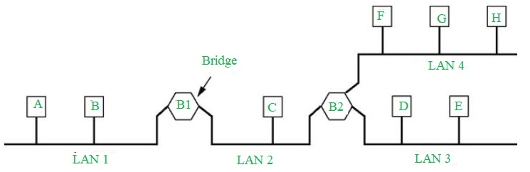
What are Bridges?
The bridge is a networking device in a computer network that is used to connect multiple LANs to a larger LAN. In computer networks, we have multiple networking devices such as bridges, hubs, routers, switches, etc, each device has its own specification and is used for a particular purpose.
Types of Bridges
There are three types of bridges in computer networks, which are as follows:
Transparent Bridge: Transparent bridges are invisible to other devices on the network.
Source Routing Bridge: Source routing bridges were developed and designed by IBM specifically for token ring networks.
Translational Bridge: Translational bridges convert the received data from one networking system to another.

Slide 4
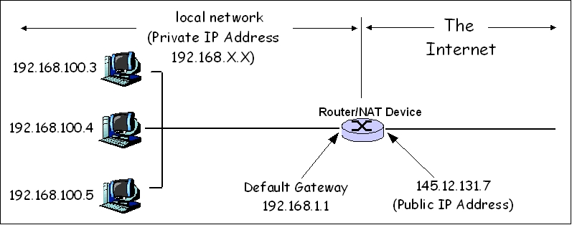
What is IP Addressing?
An IP address, or Internet Protocol address, is a unique string of numbers assigned to each device connected to a computer network that uses the Internet Protocol for communication.
It serves as an identifier that allows devices to send and receive data over the network, ensuring that this data reaches the correct destination.

Slide 5
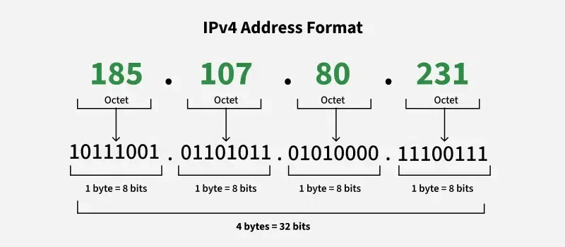
Classful Addressing:
Classful IP addressing is a way of organizing and managing IP addresses, which are used to identify devices on a network.
IPV4 Address
An IPv4 address is a unique number assigned to every device that connects to the internet or a computer network.
Format:
An IPv4 address is written as four numbers separated by periods, like this: 192.168.1.1. Each number can range from 0 to 255.

Slide 6
Thank You!

